Slide 1

Are You Suitable For Credit?
11 June 2024
Group 4
Olivia Yu
Oliver James Uy
Liwei Jiang
Notes:
Olivia

Slide 2


AIM
Generate a well-performing prediction model for assessing the eligibility for a credit card.
Evaluate the determining factors considered by financial institutions when assessing an individual’s suitability for credit.
Explore how to improve the accuracy of chosen classification models that predict who are suitable targets for a credit card application.
Notes:
Olivia

Slide 3
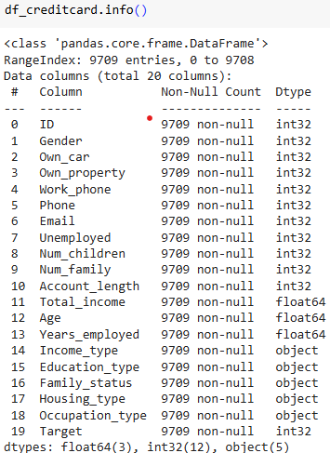

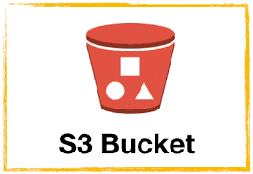


DATA SOURCE & PROCESSING
Credit Card Eligibility Data: Determining Factors (https://www.kaggle.com/datasets/rohit265/credit-card-eligibility-data-determining-factors)
Has a wide range of features including demographic, financial, personal attributes
9709 non-null rows
Store data in s3 bucket to retrieve by Spark
Generated dummies for non-numeric fields
Notes:
Olivia

Slide 4

METHODOLOGY
General data transformation
train_test_split()
Scale the data
Reduce outlier effects
Models & Optimisation
Random Forest
Neural Network (deep learning)
K-Means & KNN
Notes:
Olivia

Slide 5
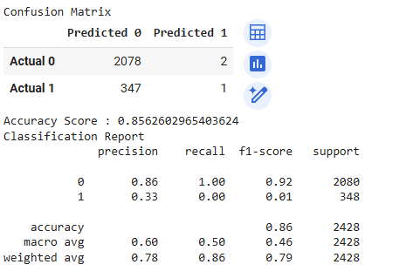
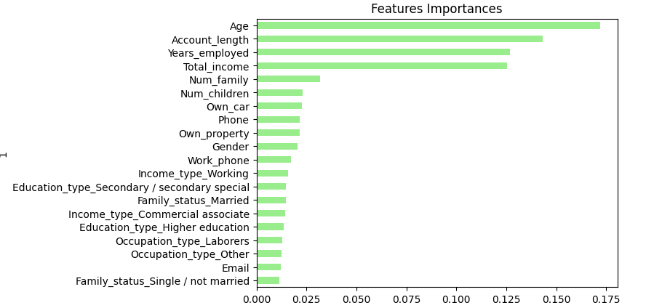
RANDOM FOREST
Confusion matrix
 | Predicted 0 | Predicted 1
Actual 0 | 2078 (True negative: creditworthy) | 2 (False positive: creditworthy assessed as not creditworthy)
Actual 1 | 347 (False negative: not creditworthy assessed as creditworthy) | 1 (True positive: not creditworthy)
Notes:
LiWei
While the model returned a high accuracy result, it is important to note that class 0 has more instances/data points which helped improve the rating. It is important to note that class 1 had 0 recall which means the model was not able to correctly identify instances for class 1.
Total of 53 features, 20 were chosen

Slide 6
NEURAL NETWORK
Further data cleansing: Winsorize (90%) the data to reduce the effect of outliers
Table: Iterative models (changes from initial model highlighted in dark teal)
 | Hidden layers (HL) | Units | Activation | Epochs | Accuracy
NN1 | 0 | Input: 20 Output: 1 | Input: ReLu Output: Sigmoid | 50 | 0.8678
NN2 | 0 | Input: 20 Output: 1 | Input: Tanh Output: Sigmoid | 50 | 0.8678
NN3 | 1 | Input: 32 HL1: 16 Output: 1 | Input: ReLu HL1: ReLu Output: Sigmoid | 80 | 0.8674
Notes:
LiWei
Confusion matrix for neural network yielded the same results as the random forest model
90% Winsorization, the bottom 5% of the values are set equal to the value corresponding to the 5th percentile while the upper 5% of the values are set equal to the value corresponding to the 95th percentile

Slide 7
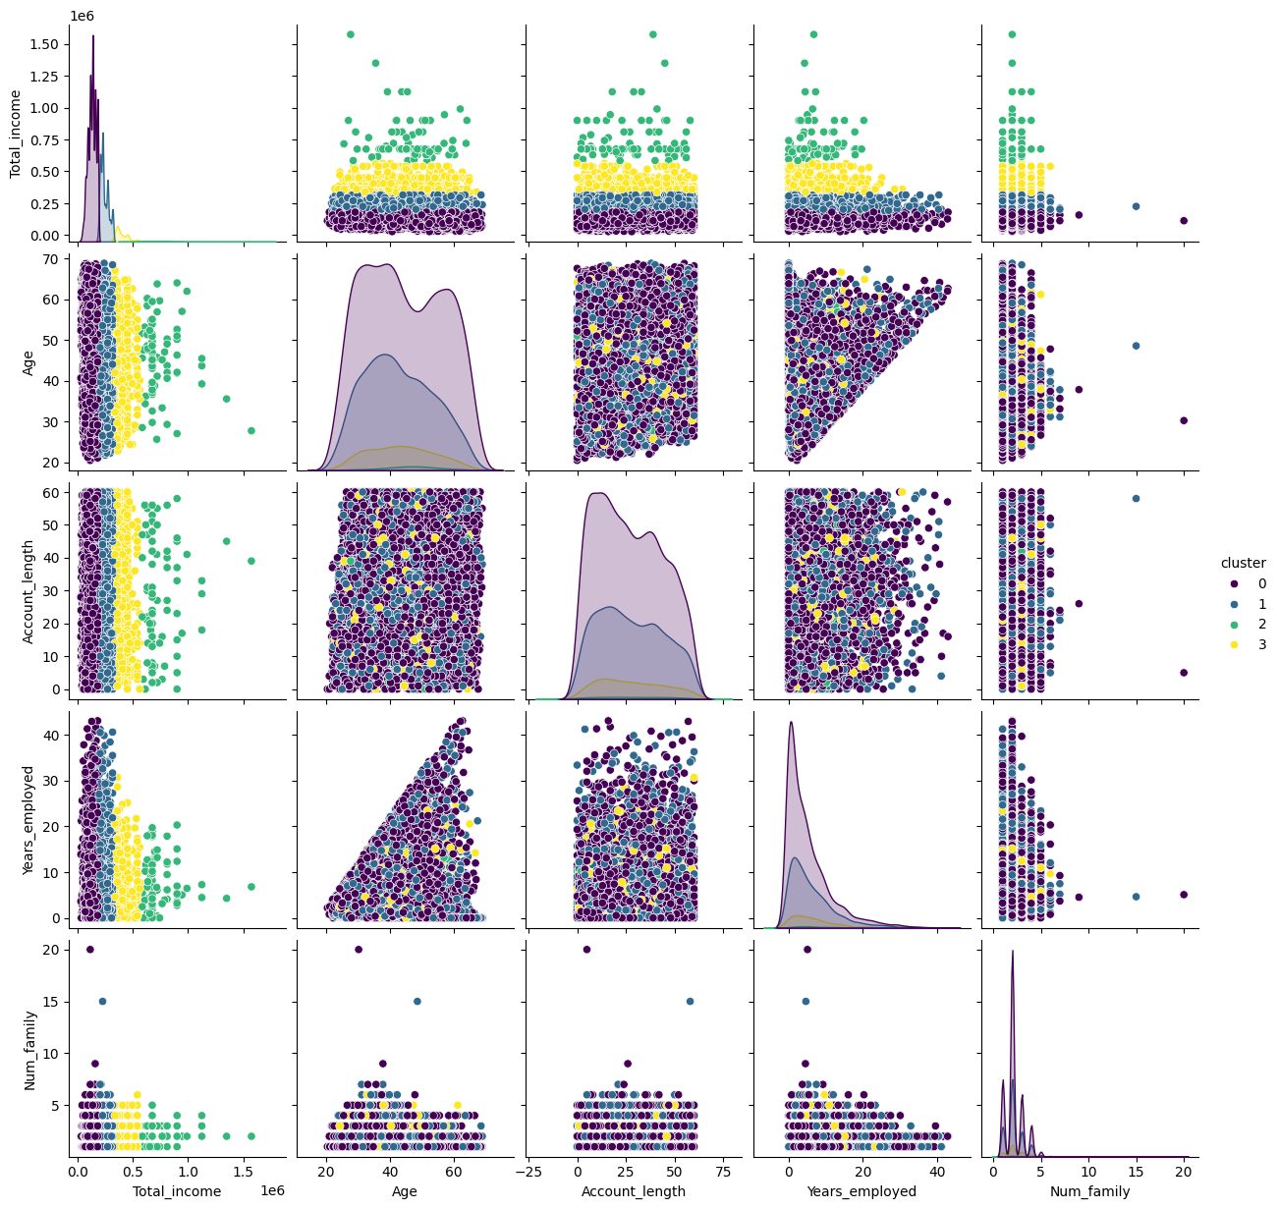
K-Means Cluster Visualisations
Notes:
Oliver
Plotting the Data: This code plots the top 5 features identified and pairs them together. This visualization helps in checking which pairs have clusters that are perfectly separable. This helps identify relationships and patterns in the data.
Key Pairs: Total Income stands out as particularly informative when paired with other features, displaying a clear and noticeable relationship. This validates what is in the actual world where income is a key component of Credit Worthiness.
Analysis: Total Income seems to be the driver in prediction.
Accuracy: The unusually high accuracy score of 1 obtained by the KNN model can be attributed to the cleaned & pre-processed nature of the data. Synthetic data is often clean and properly categorized, making it easier for the model to predict outcomes accurately. While this high accuracy is encouraging, it's important to acknowledge that real-world data may present greater challenges and variability.

Slide 8
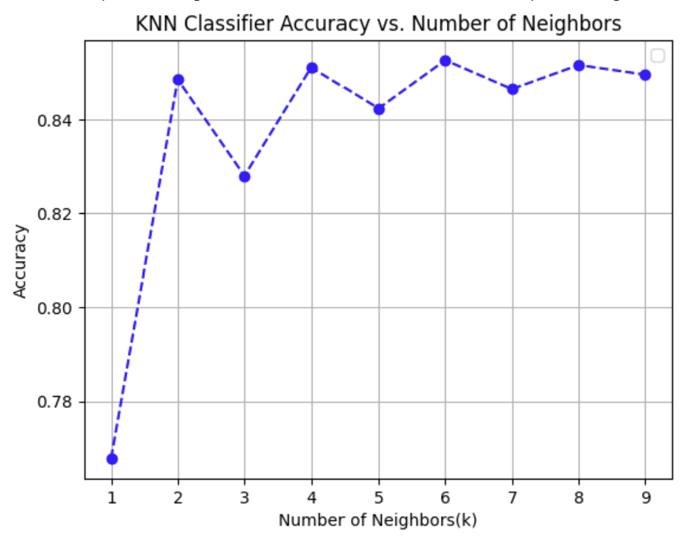
K-Nearest Neighbor (K-NN)
Cross Validation done to show model can still handle new situations accurately.
6 neighbours had the highest accuracy
Notes:
Oliver
Results represent that as the number of data points increase, the accuracy of prediction for “credit targets” increases. This reached a peak at 6 neighbors.

Slide 9
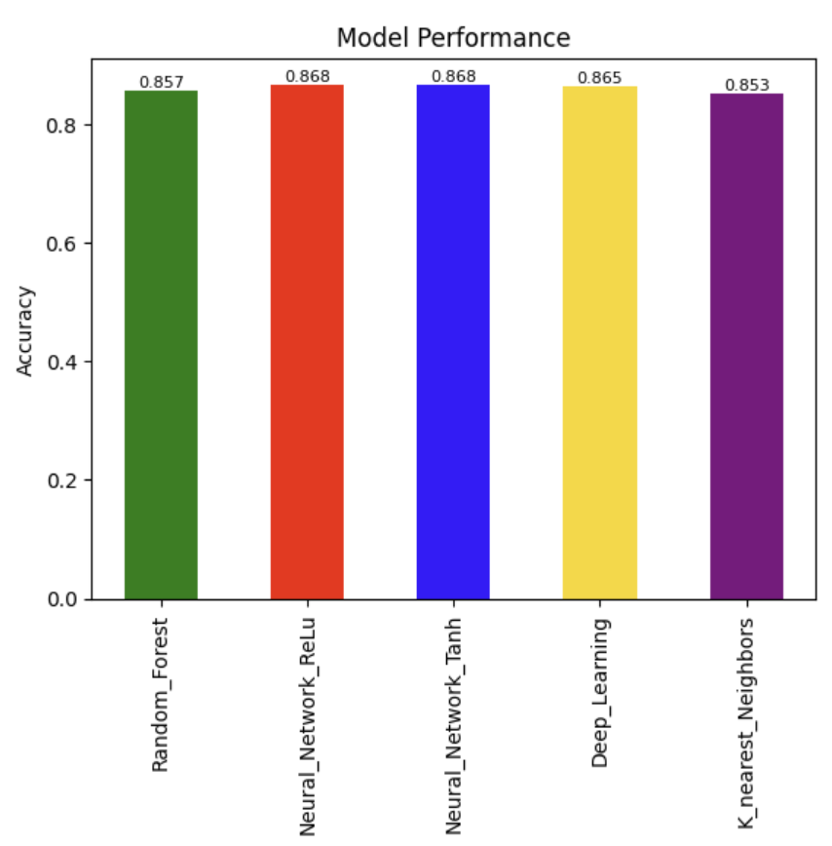
MODEL COMPARISON
All models returned similar accuracy scores
The ‘simple’ neural network performed the best, regardless of input activation method
Notes:
Oliver

Slide 10


LIMITATIONS
Small dataset
Lack of representativeness of larger population
Limited scope and insights derived
Poorer generalisability & transferability
Data source context not stated
May not be generalised to your own use case
May miss subtle nuances or potential anomalies in own specific context
Therefore, may not be completely accurate or reliable for own use case, however, modelling and optimisation steps still applicable
Notes:
Oliver

Slide 11
FUTURE ENHANCEMENTS
Larger dataset
For a more accurate use-case and generalisability, use data with similar context
Adopt other machine learning techniques (not covered in the course) to overcome small dataset
Self-supervised learning, semi-supervised learning
Cross validation techniques
Notes:
Oliver

Slide 12
Thank you

